Slide 1

Zepto Inventory Analysis
By - Sanjay Singh

Slide 2
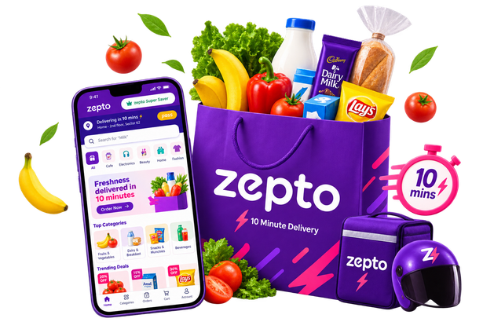
Company Overview
Zepto is a quick-commerce business that offers a wide range of products across multiple categories, with a focus on product availability, competitive pricing, discounts, and efficient inventory management.
The business maintains product-level data covering categories, product names, MRP, discount percentages, discounted selling prices, available quantities, product weights, stock status, and quantities.
As the business grows, management needs to understand product value, pricing strategies, discount patterns, revenue potential, inventory levels, stock availability, and category performance to make informed business decisions.

Slide 3
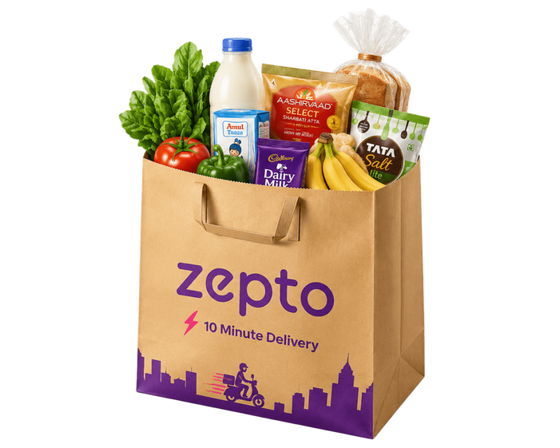
Business Questions
01. What are the top 10 best-value products based on discount percentage?
02. What are the products with high MRP but currently out of stock?
03. What is the estimated revenue for each category?
04. Which products have MRP greater than ₹500 and discount below 10%?
05. What are the top 5 categories offering the highest average discount percentage?
06. What is the price per gram for products above 100g, sorted by best value?
07. How can products be grouped into Low, Medium, and Bulk inventory segments?
08. What is the total inventory weight per category?
09. Which product categories have the highest total inventory quantity?

Slide 4
Business Questions
10. What are the top 10 products generating the highest estimated revenue?
11. Which categories have the highest number of out-of-stock products?
12. What percentage of products are currently out of stock?
13. Which products have the highest discount amount?
14. What is the average MRP and discounted selling price for each category?
15. Which categories have the highest potential revenue from available inventory?
16. Which products have high inventory quantity but relatively low discounts?
17. What is the distribution of products across different inventory quantity segments?
18. Which categories have the highest average price per gram?

Slide 5
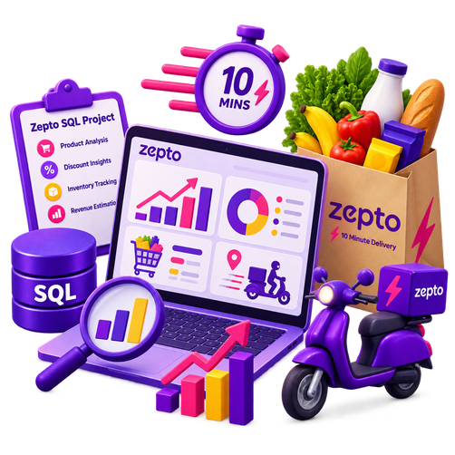
SQL Analysis
Product Performance: Identifying high-value and high-revenue products.
Pricing Analysis: Comparing MRP, selling prices, discounts, and price per gram.
Discount Analysis: Evaluating discount percentages and absolute discount amounts.
Inventory Management: Assessing inventory quantities, weight, and product-level stock distribution.
Stock Availability: Identifying out-of-stock products and categories.
Revenue Potential: Estimating revenue at product and category levels.
Category Performance: Comparing pricing, discounts, inventory, and revenue across categories.

Slide 6

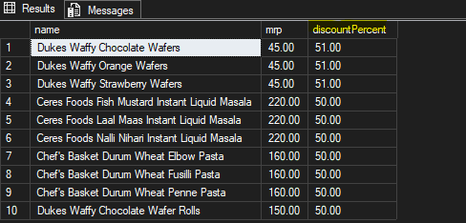
Data Analysis
Q1. Find the top 10 best-value products based on the discount percentage.

Slide 7

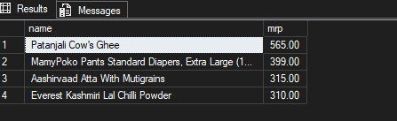
Data Analysis
Q2.What are the Products with High MRP but Out of Stock

Slide 8
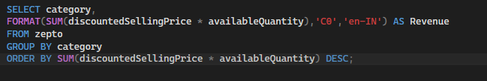
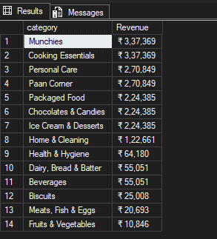
Data Analysis
Q3.Calculate Estimated Revenue for each category

Slide 9

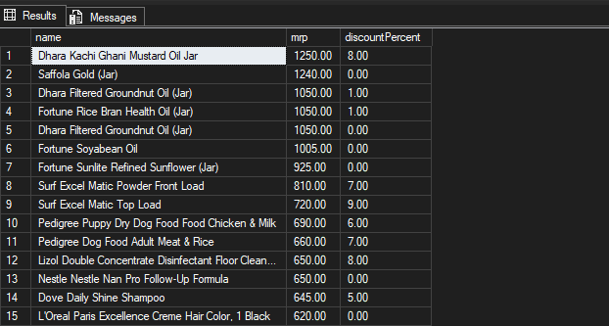
Data Analysis
Q4. Find all products where MRP is greater than ₹500 and discount is less than 10%.

Slide 10
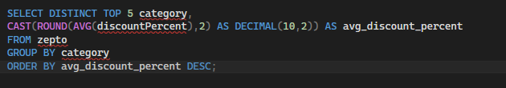
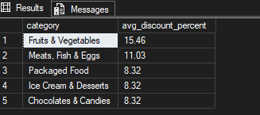
Data Analysis
Q5. Identify the top 5 categories offering the highest average discount percentage.

Slide 11
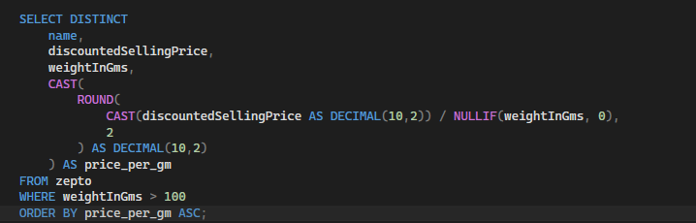
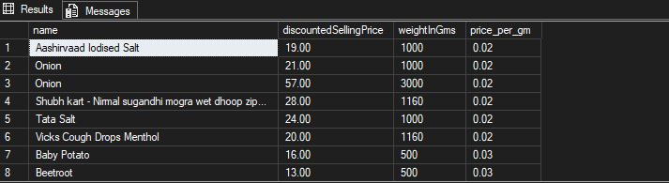
Data Analysis
Q6. Find the price per gram for products above 100g and sort by best value.

Slide 12
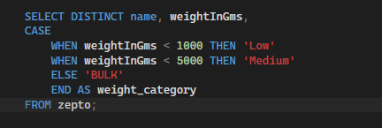
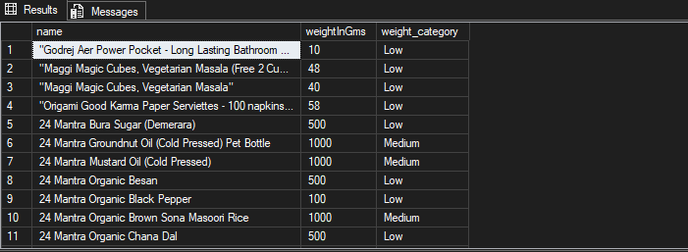
Data Analysis
Q7.Group the products into categories like Low, Medium, Bulk.

Slide 13

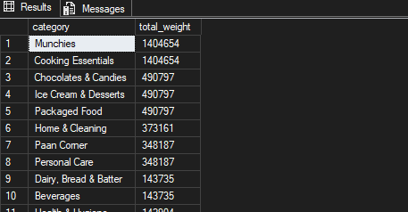
Data Analysis
Q8.What is the Total Inventory Weight Per Category?

Slide 14
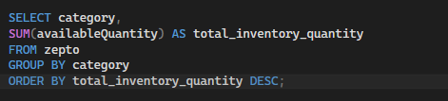
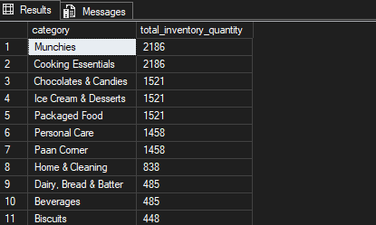
Data Analysis
Q9. Which product categories have the highest total inventory quantity?

Slide 15

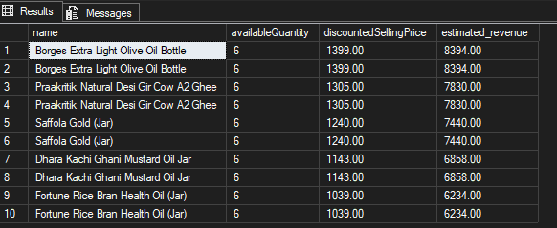
Data Analysis
Q10. What are the top 10 products generating the highest estimated revenue?

Slide 16
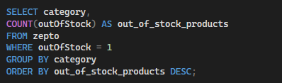
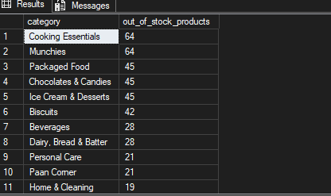
Data Analysis
Q11. Which categories have the highest number of out-of-stock products?

Slide 17
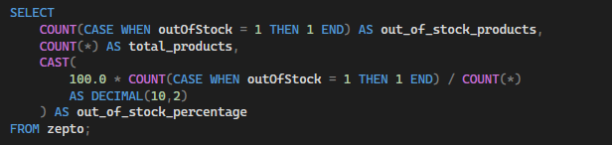

Data Analysis
Q12. What percentage of products are currently out of stock?

Slide 18
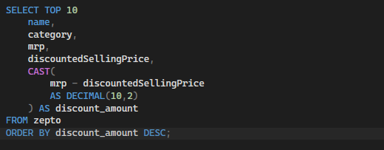
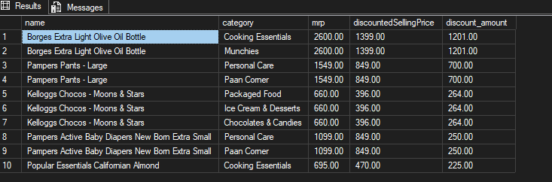
Data Analysis
Q13. Which products have the highest discount amount (MRP − discounted selling price)?

Slide 19
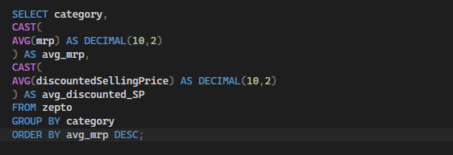
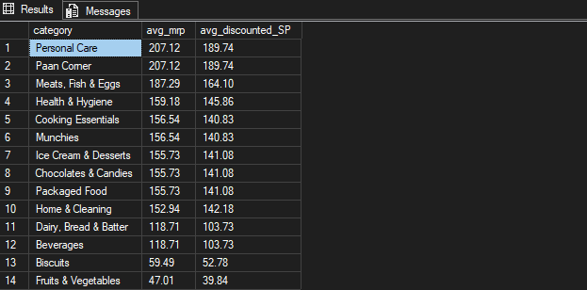
Data Analysis
Q14. What is the average MRP and discounted selling price for each category?

Slide 20
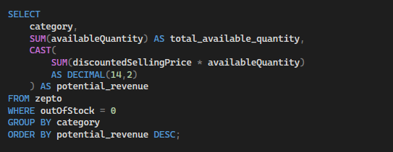
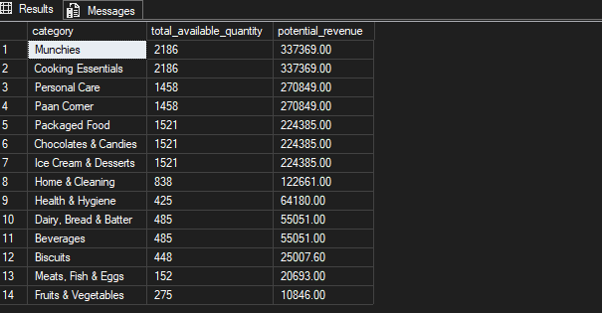
Data Analysis
Q15. Which categories have the highest potential revenue from currently available inventory?

Slide 21
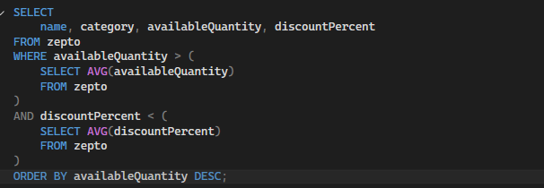
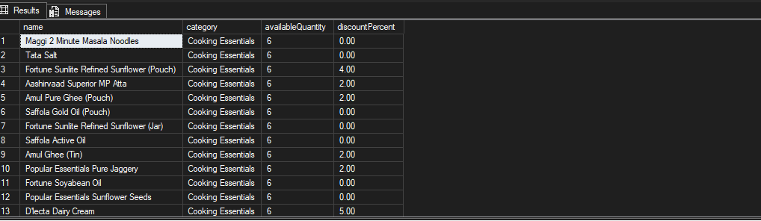
Data Analysis
Q16. Which products have high inventory quantity but relatively low discounts?

Slide 22
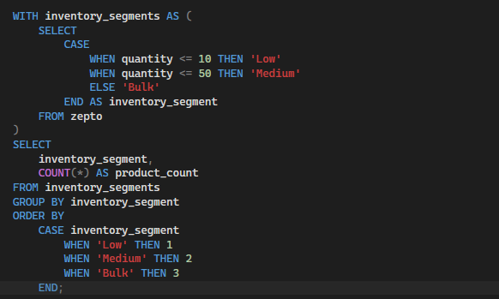
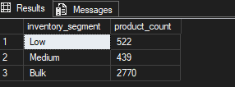
Data Analysis
Q17. What is the distribution of products across different inventory quantity segments?

Slide 23
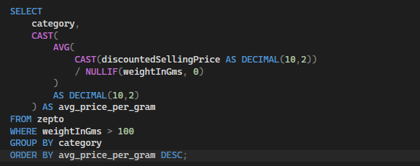
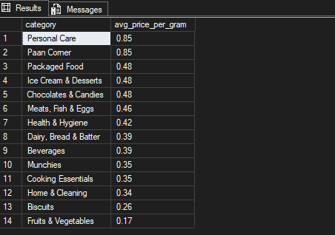
Data Analysis
Q18. Which categories have the highest average price per gram?

Slide 24

Key Insights
Product Value: Identify products offering the highest discounts and best price-per-gram value.
Pricing Strategy: Evaluate MRP, selling prices, discount percentages, and discount amounts.
Revenue Potential: Identify products and categories with the highest estimated revenue potential.
Inventory Performance: Analyze inventory quantities, weight, and product-level stock distribution.
Stock Availability: Measure overall stock-out levels and identify categories with higher stock-outs.
Category Performance: Compare categories based on revenue, inventory, pricing, discounts, and product value.
Inventory Efficiency: Identify high-inventory products with relatively low discounts.
Inventory Segmentation: Classify products into Low, Medium, and Bulk inventory segments.

Slide 25
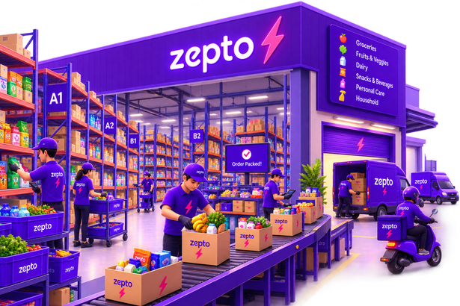
Recommendations
Prioritize replenishment for high-MRP products and categories experiencing frequent stock-outs to minimize potential lost sales.
Focus inventory investment on high-revenue products and categories with strong revenue potential.
Optimize discount strategies by evaluating categories and products with exceptionally high discount percentages or discount amounts.
Review high-inventory, low-discount products and consider targeted promotions to improve inventory movement.
Use price-per-gram analysis to evaluate product value and support competitive pricing decisions.

Slide 26
Recommendations (Cont)
Optimize inventory allocation by monitoring categories with high inventory quantities and physical inventory weight.
Leverage inventory segmentation to develop targeted replenishment and stock-monitoring strategies for Low, Medium, and Bulk products.
Monitor stock-out percentage regularly to maintain healthy product availability and improve customer experience.
Prioritize high-potential categories based on available inventory and estimated revenue to improve resource allocation.
Continuously evaluate category-level pricing and discount patterns to balance customer value, sales potential, and inventory efficiency.

Slide 27
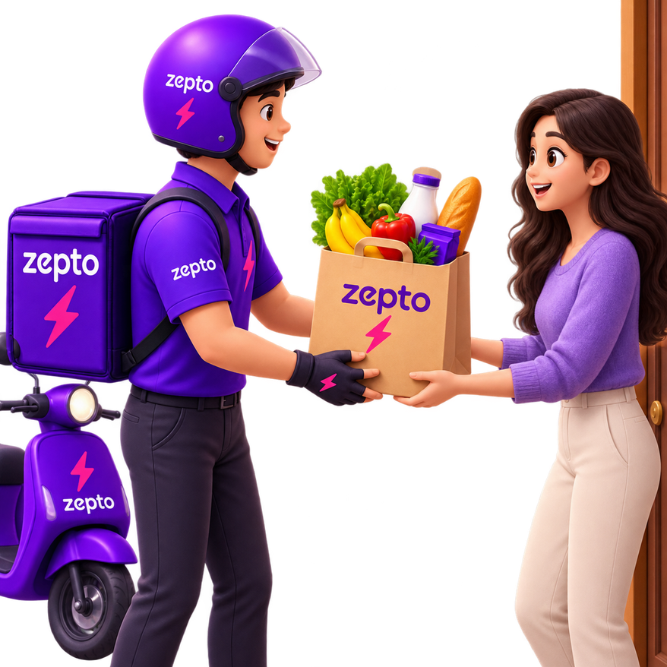
THANK YOU!

